Slide 1
JCD 891 – MINOR PROJECT Development of Fully Homomorphic Encryption Scheme
Submitted By: Tarun Chauhan Submitted To: Prof. Ashok K Bhateja
(2022JCS2670)

Slide 2

Contents
Problem Statement
Homomorphic Encryption
Why Homomorphic Encryption?
Partially Homomorphic Encryption Schemes
1. RSA
2. GM Cryptosystem
3. Paillier Cryptosystem
Somewhat Homomorphic Encryption Schemes
1. BGN Cryptosystem
Limitations

Slide 3
Problem Statement
Problem - For a third party to work on any encrypted data, it needs to decrypt the data first. This creates a privacy issue for the user, as the third party service providers like cloud storage, file sharing, collaboration, servers can keep physically identifying elements of users long after the user has ended the relationship with the services.
Solution – We need to develop a scheme that can operate on encrypted data. This scheme is referred to as Homomorphic Encryption scheme.

Slide 4
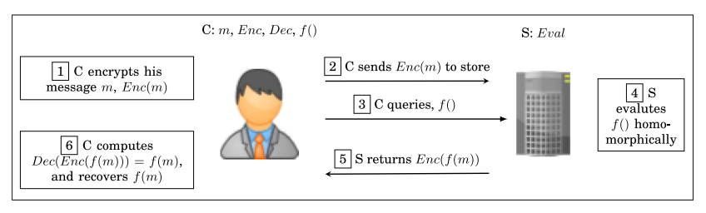
Homomorphic Encryption
Homomorphic encryption is a form of encryption that allows computations to be performed on encrypted data without first having to decrypt it.
An encryption scheme is called homomorphic over an operation " * ", if it supports the following equation:
E(m1) * E(m2) = E(m1 * m2), ∀m1,m2 ∈ M
An HE scheme is primarily characterized by four operations: KeyGen, Enc, Dec, and Eval.

Slide 5
Why Homomorphic Encryption?
Confidentiality Problem
Ability to compute over ciphertext instead of plaintext
One could use information without knowing the content of that information
Privacy guaranteed
Homomorphic Encryption is of three types:
Partially Homomorphic Encryption(PHE)
Somewhat Homomorphic Encryption(SWHE)
Fully Homomorphic Encryption(FHE)

Slide 6
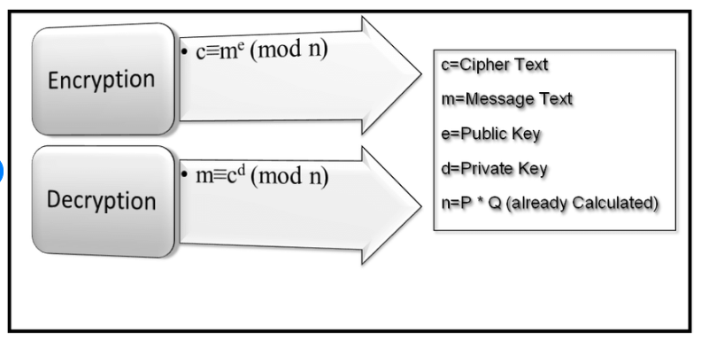
Partially Homomorphic Encryption Schemes
RSA
Security Assumption - Hardness of Factoring Problem
Homomorphic Property:
m1, m2 ∈ M
E(m1) ∗ E(m2) = (m1^e (mod n))∗(m2^e (mod n))
= (m1 ∗ m2)^e (mod n)
= E(m1 ∗ m2)
Homomorphic over multiplication operation.

Slide 7

Continued...
2. GM Cryptosystem
Security Assumption – Hardness of Quadratic Residuosity Problem
KeyGen : n = pq, x - a quadratic non-residue modulo n
Public key = (x,n) ; Private key = (p,q)
Encryption : message is encrypted bit by bit, y_i is a quadratic non-residue value
Decryption: To decrypt the ciphertext c_i , one decides whether c_i is a quadratic residue modulo n or not; if so, m_i returns 0, or else m_i returns 1.
Homomorphic Property:

Slide 8


Continued...
3. Paillier Cryptosystem
Security Assumption :Composite Residuosity Problem
KeyGen : public key =(n,g) private key = (p,q)
Encryption: For each m choose a random r,
Decryption :

Slide 9
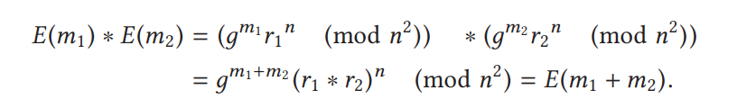
Homomorphic Property :
Homomorphic over addition operation.

Slide 10




Somewhat Homomorphic Encryption Schemes
BGN Cryptosystem
Security Assumption : Subgroup Decision Problem
KeyGen : public key = (n,G,G1,e,g,h) , here n =q1*q2 and e : G × G → G1
Private key = (q1)
Encryption: choose a random r
Decryption: first compute and let

Slide 11
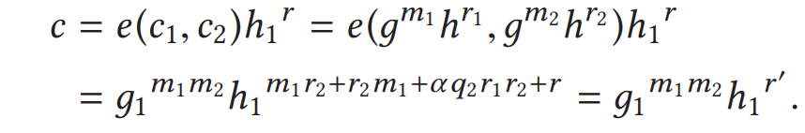
Homomorphic Property:
Addition - Homomorphic addition of plaintexts m1 and m2 using ciphertexts E(m1) = c1 and E(m2) = c2
where r = r1 + r2 + r and it can be seen that m1 + m2 can be easily recovered from the resulting ciphertext c.
Multiplication - The homomorphic multiplication of messages m1 and m2 using the ciphertexts c1 = E(m1) and c2 = E(m2) are computed as follows:
It is seen that r is uniformly distributed like r and so m1m2 can be correctly recovered from resulting ciphertext c.

Slide 12
Limitations
Computational complexity
Performance is often a disadvantage.
Do not provide verifiable computing.
Number of homomorphic functions and the number of times they can be applied is limited.

Slide 13
Thank You!

